Slide 1
Autism In Adulthood
A Personal and Professional Look at ASD Across the Lifespan
©2012 Jared Stewart, M.Ed.
No claim to copyright is made for ANY of the images in this presentation, all of which are utilized for educational purposes only.

Slide 2
Who We Are
ScenicView Academy
Established in 2001
Non-Profit Residential and Day School
Population
“High Functioning” Adults 21+
Autism Spectrum Disorders
Learning Disabilities
Target = “independent, fulfilling lives”

Slide 3
Who I Am
Jared Stewart, M.Ed.
Married, 3 children
BYU grad, Magna Cum Laude (Perfect 4.0 GPA in grad school…)
Head of the SVA Education Department
Published professional with over 10 years of experience working with ASD Adults
2011 National Educator of the Year
Adult on the Autism Spectrum! (“Aspie”)
(at least until the DSM V… ☺)

Slide 4
The 3 “Terrible Questions”
Will my child (I) ever live on their (my) own?
Will my child (I) ever have a job?
Will my child (I) ever be normal?
(What will happen to my child when I die?)

Slide 5
Please don’t be offended…

Slide 6
Prevalence of ASD
<1980’s = 1 in 2,500
2007 CDC study = 1 in 150
2012 CDC study = 1 in 88 nationwide
United Kingdom = 1 in 68
South Korea = 1 in 38
Utah = 1 in 47! (highest rate in US)
Utah Males = 1 in 32!
Current estimates = >1% worldwide
Sources: Baron-Cohen, Cambridge Autism Research Centre, 2008
Pinborough-Zimmerman, et al., 2011
www.cdc.gov

Slide 7
The Autism “Tsunami”
“[T]he discussion of autism to date has skewed, understandably, toward its impact on childhood. But the stark fact is that an epidemic among children today means an epidemic among adults tomorrow.”
~The Atlantic, 10/10
1-2% of all children…
MILLIONS of ASD individuals who will soon be adults
What Then?

Slide 8
Dr. Tony Attwood:
“ Professionals and service agencies tend to see children and adults with [Autism Spectrum Disorders] who are having problems that are highly conspicuous and difficult to treat or resolve, and this may lead to an overly pessimistic view of the long-term outcome.”
The Complete Guide to Asperger’s Syndrome, 2007; emphasis added

Slide 9
Characteristic Strengths of ASD
Powerful learning style strengths (implicit; vis/spat.; log/math; naturalistic; etc)
Exceptional rote memory (often vast stores of facts and figures)
Exceptional visual abilities (static spatial, illusions, patterns, colors, etc)
Exceptional auditory abilities (hyperconnected auditory brain centers)
Superior ability to process/locate information
Laser-like focus of energies/attention on topic of interest
Highly deductive/analytic
Strongly logical—able to make more rational decisions than NT’s
Ability to put ideas together in a unique manner—highly creative
Exceptional ability with puzzles, mazes, and word games
Exceptional ability to systematize
Ability to thrive on routines and clear expectations
Valuable employment characteristics: persistent, accurate, logical, reliable
Five times more likely than “neurotypicals” to have perfect pitch
Ten times more likely to have savant skills (music, art, calculation, etc)
Great honesty and respect for rules
Deep concern, caring, and love for “safe” beings
Deep curiosity and desire to learn (usually prefer independent learning)
Idealism and a strong sense of right and wrong/social justice
Often natural leaders
Perfectionism
Sources: Attwood (2007); Baron-Cohen (2008); Dolan et al (2008); Happe (1999); Heaton et al (2008); Grandin (2008); Remington et al (2012);
Reser (2011); Samson , et al (2011); Stewart (2007); Xiong (2012)
“Recent data…suggest it’s time to start thinking of autism as an ADVANTAGE in
some spheres, not a cross to bear.” ~Dr. Laurent Mottron, University of Montreal

Slide 10
Adults with ASD Vs Kids with ASD: What’s the Difference?
Disclaimers:
Unique disorder
Complicated, Little-Understood disorder
(No one is studying adult autism!!!)
New and Evolving disorder
Invisible disorder
Dr. Peter Gerhardt: “Nobody, it seems, goes to college to work with adults with autism.” Autism research has exploded: increasing 10-fold in the last 20 years, but adult research has actually decreased from 3% to barely 1% of the literature!
Notes:
(Ghazzuiddin, Tsai and Ghazzuiddin, 1992; Leekam, Libby, Wing, Gould & Gillberg, 2000; Klin & Volkmar, 1997; Wing, 1981; Szatmari, Bryson, Boyle, Streiner & Duku, 2003; Tsai, 1994.)

Slide 11
Adults with ASD vs Kids with ASD: So What Can Be Said?
Older (Rule of 2/3)
Dr. Paul Shattuck: “Their development is not frozen in time and forever the same. That’s just not the case.”
Mirror Neurons:
Function not as impaired as once thought (Dinstein et al, 2010)
Not broken, just slowly developing (Jojanneke et al, 2011)
Improvement with age: (Mayes and Calhoun, 2010)
Restrictive, Repetitive Behaviors (Esbensen et al, 2008)
Communication and Maladaptive Behaviors (Shattuck et al, 2007)
Executive function/goal achievement (Attwood 2007)
No longer a “disability” in apx. 15%! (Fein, 2009)
Individuals with ID do not show as much improvement, but even among those individuals, more show improvement than show decline! (Shattuck 2007)

Slide 12
Adults with ASD vs Kids with ASD: So What Can Be Said?
OUT OF THE K-12 SCHOOL SYSTEM!!!
Different rules and societal expectations
Dr. Dawn Prince-Hughes: “I stood out as a freak in school: my tics my monologues, my sensitivities, my imperviousness to criticism and suspicion of authority, my disdain for connection and avoidance of social interaction, my political convictions, my obsessions, and my odd style of dressing and speaking all led to total ostracism and aggression.
Determined to last out my high school career, I tried to find new ways to get through the day. I imagined that no one else existed in the school, so thoroughly that people literally disappeared from my sight. With my eyes fixed ahead and focused on nothing, I would wander the halls, seeing them empty, quiet, hallowed. I became unable to hear my teachers and would be speechless when they called on me…I was swimming in a sea of ugliness, hate and intolerance…I was drowning.”

Slide 13
Adults with ASD vs Kids with ASD: So What Can Be Said?
OUT OF THE K-12 SCHOOL SYSTEM!!!
Different rules and societal expectations
Greater freedom and broader choices
Dr. Dawn Prince-Hughes: “[Going to college] was very difficult and scary: I had abandoned school and was thrown into terror every time I considered going back… [but college] people, to my amazement… would help me. I still looked away a lot. I rocked and cleared my throat loudly and compulsively. I laughed at things that weren’t funny to them, and I interjected thoughts that they didn’t think were relevant.
In spite of these things, they understood not only what I was trying to say in real social situations, but what I wanted to do with my life. I learned what was expected of me as a new college student… I was free to come and go as I pleased, and in addition to my formal learning I continued to read all I could… I was never so happy. I had to deal with only a few people, usually one on one, and I could spend all my time learning.” Songs of the Gorilla Nation

Slide 14
Adults with ASD vs Kids with ASD: So What Can Be Said?
Improved Social Potentials
Better “Masks” and better at controlling focus
Fixations/Focus Areas/“Special Interests” broader
Have some social circle (often online…)
“Sometimes parents and professionals worry too much about the social life of an adult with autism. I make social contacts via my work. If a person develops her talents, she will have contacts with people who share her interests.” ~Temple Grandin

Slide 15
Adults with ASD vs Kids with ASD: So What Can Be Said?
Reap what has been Sown
Emotional scarring has left its mark
Support withdrawn (dis-abled vs. empowered)
Childhood trajectory now begins to come to fruition
Overall 33% have depression, 25% have anxiety disorders
Among those with AS/HFA 44% have depression and up to 84.1% have anxiety disorders (Marriage et al, 2009; Muris et al, 1998)
“It’s like giving someone a wheelchair on a one-month rental, and at the end of the month, they have to give it back—and walk.” ~Dr. Peter Gerhardt

Slide 16
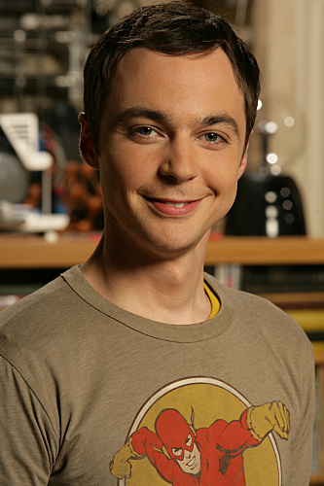
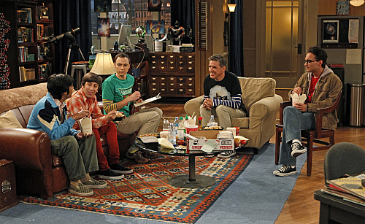
Adult ASD: What does it look like?
Maybe “Who does it look like?” would be a better question.
(Answer: The entire cast of the Big Bang Theory ☺)
Let’s begin with some famous fictional depictions of ASD
See if you can spot the pattern…
Notes:
I want to spend the bulk of my presentation giving inductive examples of the KINDS of people and characteristics which CAN be indicative of a high-functioning autism spectrum disorder such as Asperger’s Syndrome
Disclaimer: this is all merely an exercise—a thought experiment—designed to help break through the prevailing biases and stereotypes

Slide 17
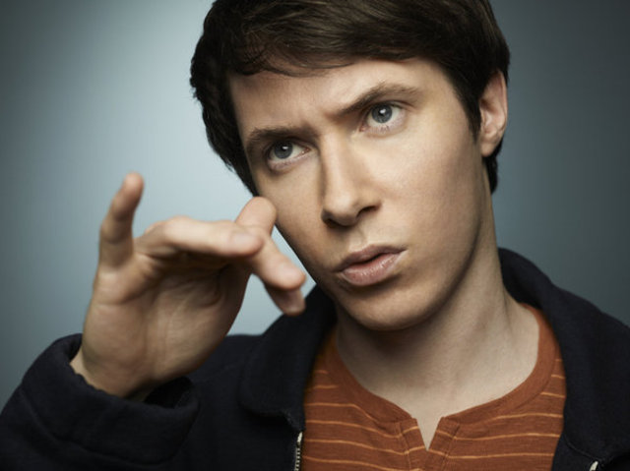
Adult ASD: Who does it look like?
Counterclockwise:
~Gary Bell (Alphas superhero)
~Astrid Farnsworth (Fringe scientist)
~Abed Nadir (Community nerd)
~Spencer Reid (Criminal Minds FBI genius)
Notes:
I want to spend the bulk of my presentation giving inductive examples of the KINDS of people and characteristics which CAN be indicative of a high-functioning autism spectrum disorder such as Asperger’s Syndrome
Disclaimer: this is all merely an exercise—a thought experiment—designed to help break through the prevailing biases and stereotypes

Slide 18
REAL Adults with ASD
The W.A.L.M.A.R.T. Cluster:
Writers (Tim Page, Liane Holliday Willey, Orson Scott Card, etc)
Actors (Darryl Hannah, Sigourney Weaver, Paddy Constantine, etc)
Leisure/Recreational (surfer Clay Marzo, gamer Satoshi Tajiri, etc)
Musicians (Marty Balin, Gary Numan, Derek Paravacini, Ladyhawke, etc)
Artists (Stephen Wiltshire, Richard Wawro, Alonzo Clemons, etc)
Research/Educational (Vernon Smith, Dawn Prince-Hughes, etc)
Technical (TONS of programmers, engineers, accountants, doctors, etc;
ASD is much higher in regions with more tech-type jobs! (Baron-Cohen et al, 2011)

Slide 19
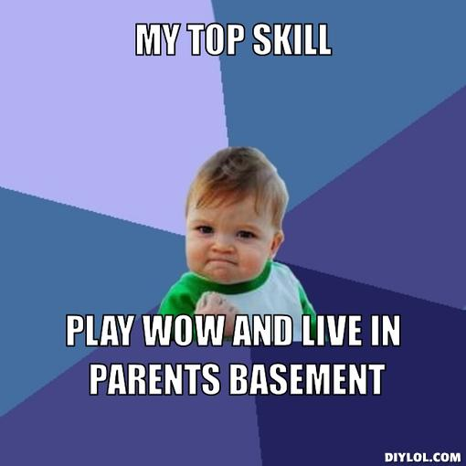
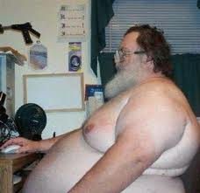
The Downside…
Hackers/Pirates (Gary McKinnon, Ryan Cleary, Adrian Lamo, etc)
Stalkers/Sex Offenders (Debbaudt, 2002; Stokes et al, 2007)
Terrorists/Killers (American Al-Qaeda Adam Gadahn , activist William Cottrell, Muslim UK bomber Nicky Reilly, etc)
“Non-productive” This is FAR more likely
– up to 90% according to the New York Times!!! (9/17/11)

Slide 20
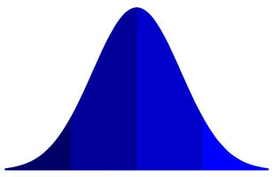
The Bell Curve:
Rule of thumb = Disorder of Extremes!
Those with ASD are best described as
“Outliers”
“Normal” Range

Slide 21
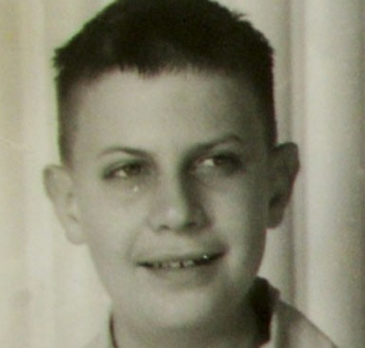
Donald Triplett — “Case 1”
Diagnosed in 1938 at the age of 5 by Dr. Kanner
The FIRST diagnosed case of autism
Fixated on spinning objects, spinning himself, and rolling nonsense words around in his mouth
Rarely listened to/obeyed his parents
Awkward movements/motor coordination
No apparent interest in other people or socializing
Poor eye contact
Assigned everyone numbers in place of names
Strong memory for numbers and mathematics
Institutionalized at age 3 as “hopelessly insane”
The Atlantic, October 2010

Slide 22
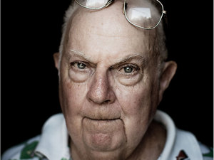
Donald Triplett — “Case 1”
Now nearly 80…
High school graduate!
Worked as a bank teller!
Lives on his own!
Golfs, drives, and travels the world—all independently!
(First developed these skills at the respective ages of 23, 27, and 36)
Still has a fairly rigid routine (but it is HIS and it involves people and positive goals like exercise, recreation, and scrapbooking)
Had Community Support (“Acceptance”) “He attended a country school where his peculiarities were accepted and where he made good scholastic progress.”
Had neighbors and friends who would “not only shrug off his oddities, but openly admire his strengths”
Had early childhood “interventions” (farming, mainly)
Had suitable goals tied to his areas of preoccupation
The Atlantic, October 2010

Slide 23
Common Denominators of Success
Bottom Line: Even with autism-spectrum characteristics, people can be WILDLY successful!
Even in more severe cases, there is always HOPE!
Study of 241 adolescents and adults with ASD (69% with ID!) over 5-year period found that
“On average, people are getting better.” (Shattuck et al, 2007)
“Science is telling us autism is not a fixed life sentence because people improve – sometimes a little bit, and sometimes a lot, and sometimes they even stay improved.”
~Dr. Martha Herbert, neurology professor at Harvard Medical School
“Critical Success Factors” Handout
SYSTEMS SYSTEMS SYSTEMS!

Slide 24
The 3 “Terrible Questions”
Will my child ever live on their own?
Will my child ever have a job?
Will my child ever be normal?
(What will happen to my child when I die?)

Slide 25
The 3 “Terrible Questions”
Will my child ever live on their own?
Will my child ever have a job?
Will my child ever be normal?
(What will happen to my child when I die?)
Recent study of diagnosed AS/HFA adults in Utah found the following:
Over 60% employed (this is roughly 33% overall for ASD’s)
Nearly 17% married
Over half live independently
(Source: Farley, 2008)
Other studies of officially diagnosed ASD adults have found that, overall, 15-25% of individuals achieve positive adaptive outcomes (Cederlund, et al 2008; Marriage, et al 2009; etc)

Slide 26
Will My Child Ever Live on their own?
YES! (but)
Accommodations often required (smart apps, case management, bill-pay, transportation, etc)
Predictable, consistent environment
MUST teach skills (in context)
Dr. Peter Gerhardt’s Question:
“Is this outcome more the result of his/her autism diagnosis, or more the result of never having been taught
a reasonable cohort of actual living skills?”

Slide 27
Will My Child Ever Have a Job?
YES! (but)
Accommodations often required (job coach, mentor/apprenticeship, training co-workers, transportation, etc)
Predictable, consistent environment
Aligned with STRENGTHS
MUST teach skills (in context)
Alison Singer, president of the Autism Science Foundation:
“Autism should never be viewed as a barrier to self-fulfillment. Employment is just a matter of making opportunities.
We have people with very strong skills who can have very productive careers. Some might not be able to, but that's also OK. We can still find productive ways for them to contribute to society.”

Slide 28
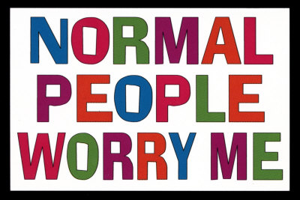
Will My Child Ever Be Normal?
“I have known some adolescents and adults [who have] progressed to a point on the continuum where only subtle differences and difficulties remain. The person has progressed to a description of personality, rather than a diagnostic category…” (Attwood 2007)
“Lifelong Eccentricity” (Tantam 1988)

Slide 29
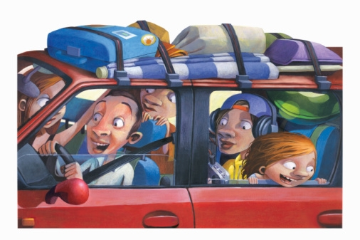
Will My Child Ever Be Normal?
Driver’s license?
Marriage?
Children?

Slide 30
The Myth of “Normal”
“Many Aspies feel the pressure to be ‘normal’. Society looks down on Aspies as bizarre, weird, and peculiar. They want Aspies to conform to the norms of society. Aspies enjoy themselves because that is who they are. In fact, most Aspies believe they are ‘normal’ and think society is bizarre, weird, and peculiar. So the real question is, ‘What is normal?’”
~ David Gratiot, ScenicView Academy student with AS (used with permission)

Slide 31
The Myth of “Normal”
“There is nothing more frustrating than the lifelong accumulation of scars that result from trying to be like normal people and failing daily. It is especially hard when your disability is invisible like mine. I spent almost forty-one years trying to be some kind of normal person that I was never meant to be.”
~AS/HFA spokesman Jerry Newport

Slide 32
The Myth of “Normal”
“All people are real, in the deepest sense of that word. That means that there is no such thing as a non-human human. But if you look around this room, you will see people who look at least non-standard. And that is where the problem begins. We live in a country where image is kind of a reality more real than reality… Eagerness to be like others didn't make Pinocchio real — it turned him into a donkey! And eagerness by parents to cure autism or retardation or compulsiveness will not drive great distances toward the final solution to the actual problem. Because the person who believes ‘I will be real when I am normal,’ will always be almost a person, but will never make it all the way.”
~ Autistic Pride advocate Eugene Marcus

Slide 33
The Myth of “Normal”
“It is no measure of health to be well adjusted to a profoundly sick society.”
~Krishnamurti

Slide 34
Debunking the Myths
“People with ASD will never truly be successful in life” = Extremely harmful!
“People with ASD are all the same, and will all benefit from the same treatment”
“People with ASD are somehow defective or deficient.”
“Common Myths” Handout
Notes:
People with AS are not all the same! (In fact they are extremely unique). Treat them that way!
Treat them like you would treat anyone from a foreign culture

Slide 35
Conclusions: So What?
Abandon our preconceived notions/stereotypes
Acknowledge that AS/HFA is not a “death sentence,” but that it is a lifelong condition (and largely culturally dictated)
Stop the panic mongering, stigmatization, and (unnecessary) institutionalization!
“Surrender the 1-up” ~ Christian Moore
Teach young adults how to problem-solve, mask and accommodate social weaknesses, and cope with the sensory/emotional issues (especially anxiety and social)
Focus on strengths; special interests = successful career!
Prudently use interventions: medication, probiotics, special diets, therapy, computers, apps, etc!
Involve individuals in their treatment decisions!
Live and Let Live— NT’s need to be more flexible too!

Slide 36
Transition Planning
ASD
World
Neurotypical World
Only acceptable outcome = indistinguishability

Slide 37
Transition Planning
ASD
World
Neurotypical World
Skills and Interests, mutually beneficial supports

Slide 38
Transition Planning Priorities
What future do you picture (for them)?
What do you want (them) to be able to do?
(If they can’t do it, who will do it for them?)
Prioritize ADAPTIVE skills over ACADEMIC skills as age increases
Vocational, Social, and Navigational skills
Prioritize multiple-environment skills
Prioritize safety/survival skills
Prioritize skills that REDUCE dependence
Adapted from Wehman (1992)

Slide 39
Q & A
Thanks for coming—enjoy the rest of the conference!!!
Please feel free to contact me:
801-342-3436
jareds@svacademy.org

